Slide 1
HOT- WORKING PROCESSES

Slide 2
Shaping of metal by deformation is a very very old tradition.
Processes such as rolling, wire drawing etc. were common in the Middle Ages. In North America, by 1680 the Saugus Iron Works near Boston had an operating drop forge, rolling mill, and slitting mill.
Although basic concepts of many forming processes have remained largely unchanged throughout history, details and equipment have evolved considerably.

Slide 3
INTRODUCTION
Manual processes were converted into machine processes during the industrial revolution.
The machinery then became bigger, faster, and more powerful.
Waterwheel power was replaced by steam and then electricity.
More recently, computer-controlled, automated operations have emerged

Slide 4
CLASSIFICATION OF DEFORMATION PROCESSES
Processes divide into the following :-
Primary processes reduce a cast material into intermediate shapes, such as slabs, plates, or billets.
Secondary processes further convert these shapes into finished or semi-finished products.

Slide 5
CLASSIFICATION OF DEFORMATION PROCESSES
Bulk deformation processes
Surface area of work piece changes significantly.
Thicknesses or cross sections of material are reduced
Shapes are changed.
As volume of material remains constant, other dimensions must change in proportion.
Enveloping surface area is altered, usually increasing as product lengthens.

Slide 6
CLASSIFICATION OF DEFORMATION PROCESSES
Sheet-forming operations
Involve deformation of material where thickness and surface area remain relatively constant.
Coining, for example, begins with sheet material but alters the thickness in a complex manner that is essentially bulk deformation.

Slide 7
HOT-WORKING PROCESSES
Hot-working processes provide means of producing a desired shape.
At elevated temperatures, metals weaken and become more ductile.
With continual re-crystallization, massive deformation take place without exhausting material plasticity.

Slide 8
HOT-WORKING PROCESSES
Some major modern hot-working manufacturing processes are:
Rolling
Forging
Extrusion
Hot drawing
Pipe welding
Piercing

Slide 9
ROLLING
Rolling is usually first process used to convert material into a finished wrought product.
Stock can be rolled into blooms, billets, slabs, or these shapes can be obtained directly from continuous casting.
A bloom has a square or rectangular cross section, with a thickness greater than 6 inches and a width no greater than twice the thickness.

Slide 10
ROLLING
A billet is usually smaller than a bloom and has a square or circular cross section. Billets are usually produced by some form of deformation process, such as rolling or extrusion.
A slab is a rectangular solid where the width is greater than twice the thickness. Slabs can be further rolled to produce plate, sheet, and strip

Slide 11
ROLLING
These hot-worked products use for subsequent processing techniques such as cold forming or for machining.
Sheet and strip fabricated into products or cold rolled into thinner, stronger material even into foil.
Blooms and billets rolled into finished products, such as structural shapes or railroad rail, or processed into semi-finished shapes, such as bar, rod, tube, or pipe

Slide 12
ROLLING
Hot Rolling :-
is prominent among all manufacturing processes
equipment and practices are sufficiently advanced
is standardized
produce uniform-quality products at relatively low cost
products are normally obtained in standard shapes and sizes

Slide 13
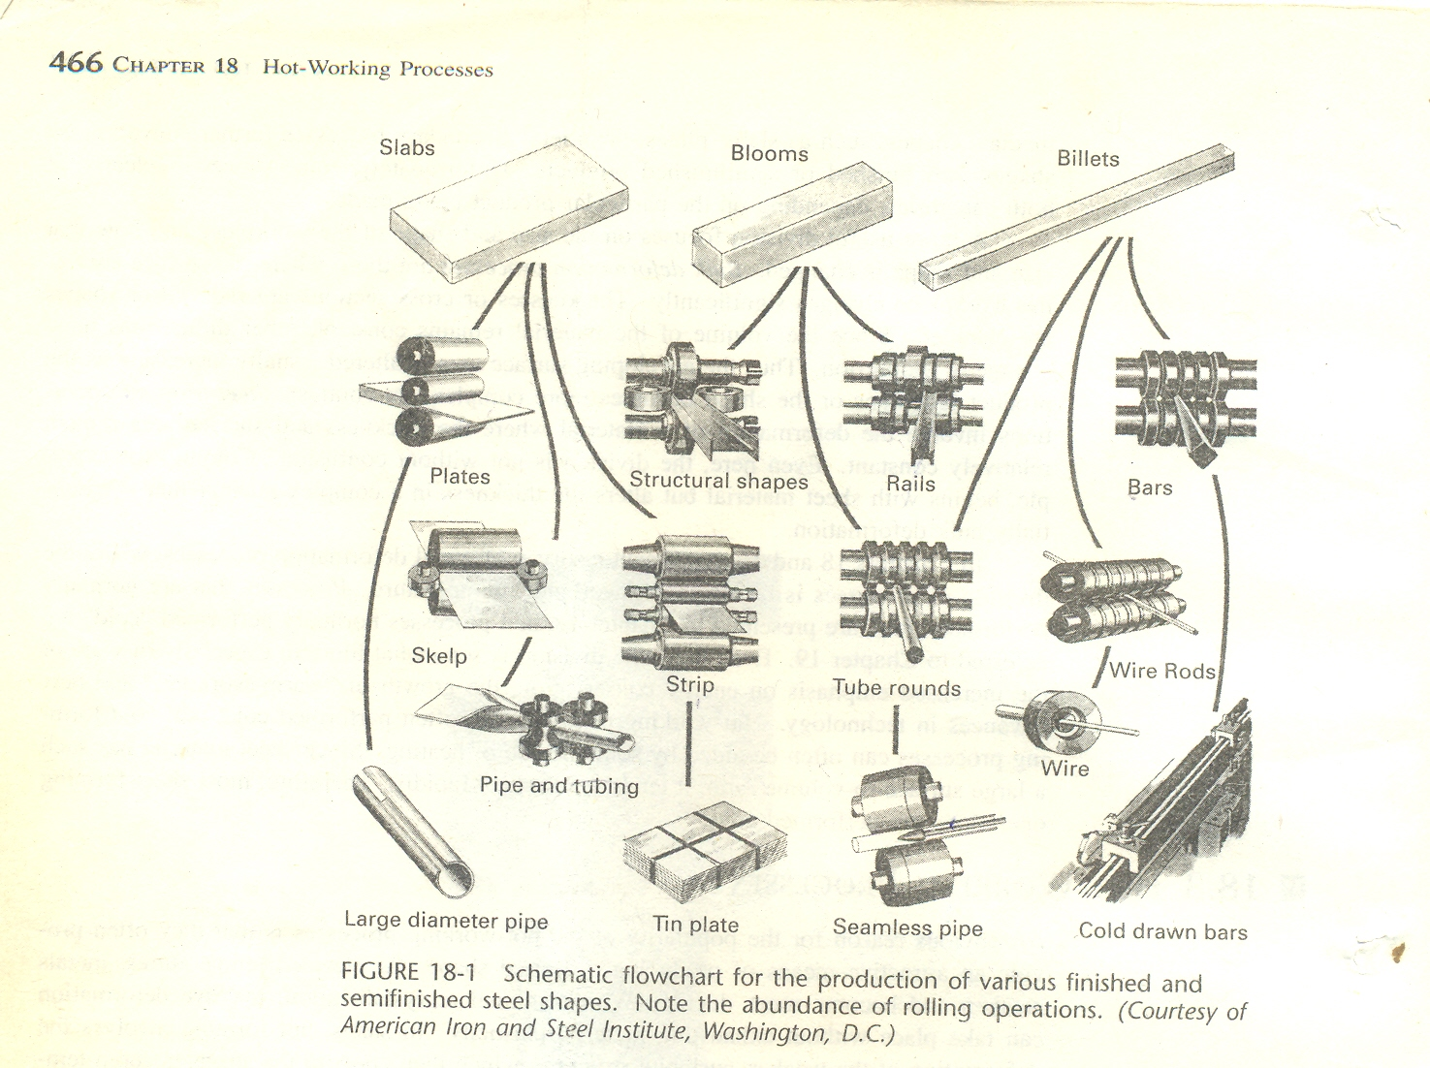

Slide 14
Basic Rolling Process
Heated metal is passed between two rolls that rotate in opposite directions
Gap between rolls is less than thickness of entering metal.
Rolls rotate with surface velocity that exceeds speed of incoming metal, friction along the contact interface acts to propel the metal forward.

Slide 15
Basic Rolling Process
Metal is squeezed and elongates result in decrease of the cross-sectional area.
Amount of deformation in a single pass depends on the friction conditions along the interface.
If too much material flow is demanded, rolls cannot advance the material and simply skid over its surface.
Too little deformation per pass results in excessive production cost ??

Slide 16
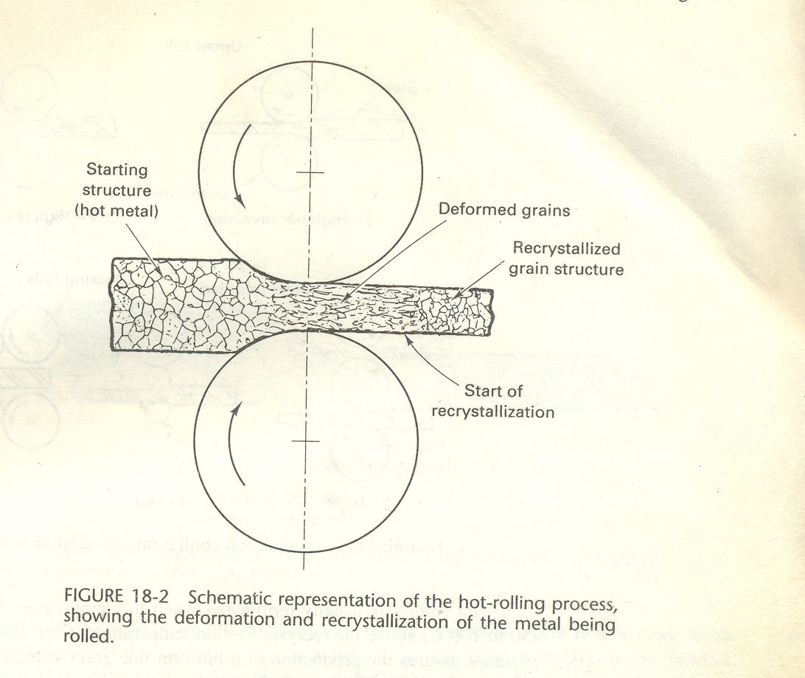

Slide 17
Rolling Temperatures
Temperature control is crucial to the success of the hot rolling process.
If the temperature of the billet is not uniform, the subsequent deformation will not be uniform.

Slide 18
Rolling Temperatures
For example
If a part cools prior to working, the cooler surfaces will tend to resist deformation.
Cracking and tearing of surface may result as hotter, weaker interior tries to deform.

Slide 19
Rolling Temperatures
Cooling from solidification is controlled to enable direct insertion into a hot-rolling operation without additional handling or reheating.
Brought to rolling temperature, usually gas- or oil-fired soaking pits or furnaces are normally used.
Plain-carbon and low-alloy steels soaking temperature is approximately 2200⁰F (l200⁰C)

Slide 20
Rolling Temperatures
For smaller cross sections, induction coils may be used to heat material for rolling
Hot rolling is usually terminated when temperature falls to about 100 to 200⁰F (50 to 100°C) above the recrystallization temperature of material
Finishing temperature assures the production of a uniform fine grain size and prevents possibility of unwanted hardening
Before additional deformation, a period of reheating is required to reestablish desirable hot-working conditions

Slide 21
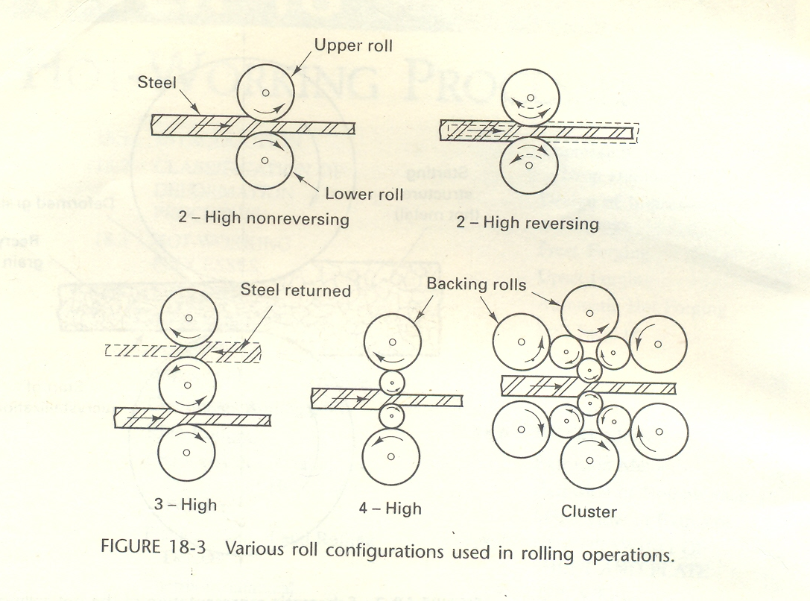

Slide 22
Rolling Mill Configurations
Rolling mill stands are available in a variety of roll configurations.
Early reductions (often called primary roughing or breakdown passes), employ two- or three-high configuration with 24- to 55-in. (600- to 1400-mm) diameter rolls
Two-high non-reversing mill simplest design from which material can only pass in one direction
Two-high reversing mill permits back-and-forth rolling, rolls may stop, reversed, and brought back to rolling speed between each pass

Slide 23
Rolling Mill Configurations
The three-high mill eliminates need for roll reversal but requires some form of elevator on each side of mill to raise or lower material and mechanical manipulators to turn or shift product between passes
smaller-diameter rolls produce less length of contact for a given reduction and therefore require lower force and less energy to produce a given change in shape
smaller cross section, however, provides reduced stiffness and pressed apart by the metal passing through the middle

Slide 25
Rolling Mill Configurations
Four-high and cluster arrangements use backup rolls to support the smaller work rolls
used in hot rolling of wide plate and sheets, and in cold rolling, where small negligence would result in an unacceptable variation in product thickness
Foil is rolled on cluster mills since small thickness requires small-diameter rolls
In a cluster mill, the roll in contact with the work can be as small as 1/4 in. in diameter

Slide 26
Rolling Mill Configurations
Pack Rolling, a process where two or more layers of metal are rolled simultaneously as a means of providing a thicker input material
Household aluminum foil is usually pack rolled, as evidenced by the one shiny side (in contact with the roll) and one dull side (in contact with the other piece of foil)
In rolling of non-flat or shaped products, such as structural shapes and railroad rail, the sets of rolls contain contoured grooves that sequentially form desired shape, cross section and control metal flow

Slide 27
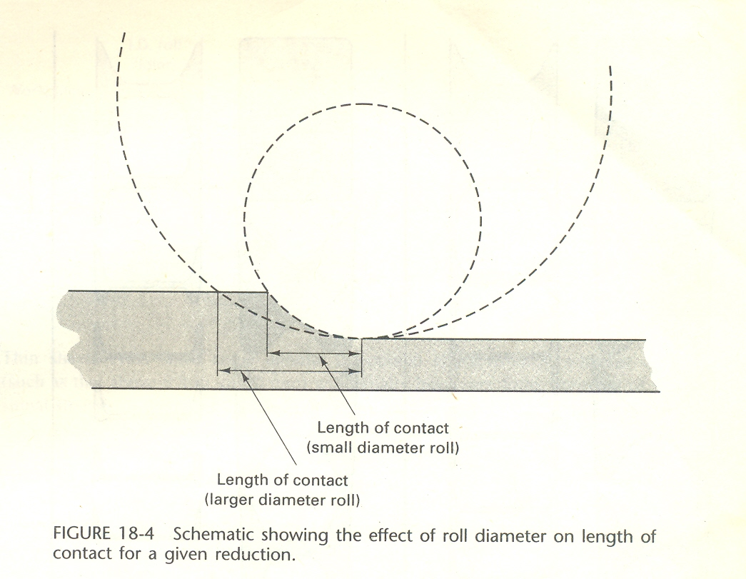

Slide 28
Continuous Rolling Mills
When the volume of a product justifies investment, it may be rolled on a continuous rolling mill.
Billets, blooms, or slabs are heated and fed through an integrated series of non-reversing stands
Continuous mills for the hot rolling of steel strip, for example, often consist of a roughing train of approximately four four-high mill stands and a finishing train of six or seven additional four-high stands.

Slide 29
Continuous Rolling Mills
In a continuous structural mill, the rolls in each stand contain only one set of shaped grooves, in contrast to the multi-grooved rolls used when the product is produced by back-and-forth passes through a single stand.
In a continuous rolling mill, same amount of material must pass through each stand in a given period of time.
If cross section is reduced, speed must be increased proportionately.

Slide 30
Continuous Rolling Mills
Thus rolls of each successive stand must turn faster than those of preceding one by an amount equal to change in cross-sectional area
If this synchronization is not maintained, material may accumulate between stands, or demand for incoming material may place material under excessive tension, and cause a tearing or rupture

Slide 31
Continuous Rolling Mills
Synchronization of six or seven mill stands is not an easy task, especially when key variables such as temperature and lubrication may change during a single run and product may be exiting final stand at speeds in excess of 70 miles per hour (110 kilometers per hour).
Computer control is important to successful rolling, and modern mills are equipped with numerous sensors to provide the needed information.

Slide 32
Ring Rolling
In ring rolling process, one roll is placed through the hole of a thick-walled ring, and a second roll presses in from outside.
As the rolls squeeze and rotate, wall thickness is reduced and diameter of ring increases.
Shaped rolls can be used to produce a wide variety of cross-section profiles.
Resulting seamless rings find application in products such as rockets, turbines, airplanes, pipelines, and pressure vessels.

Slide 33
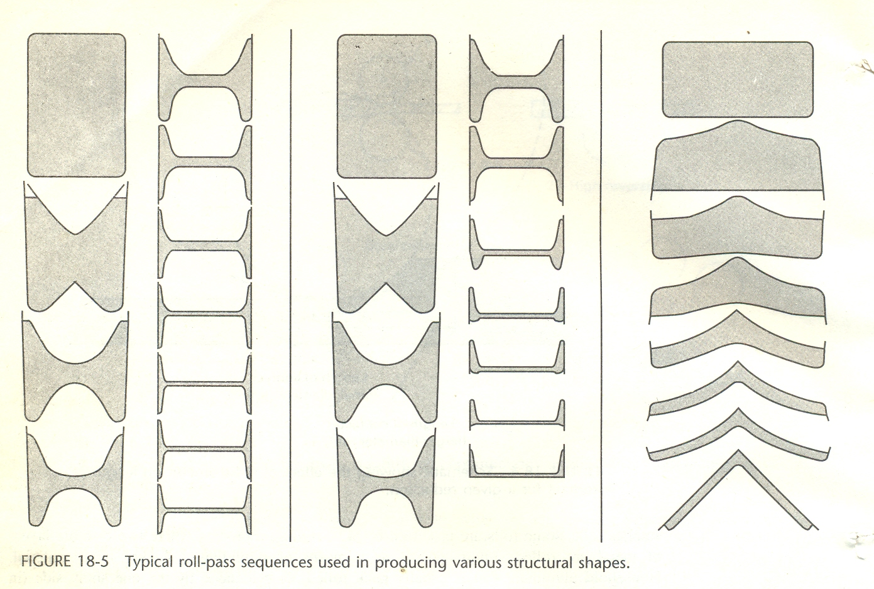

Slide 34
Characteristics of Hot-Rolled Products
Because they are rolled and finished above recrystallization temperature, hot-rolled products have little directionality in their properties and are relatively free of deformation - induced residual stresses.
These characteristics may vary, depending on thickness of product and presence of complex sections.

Slide 35
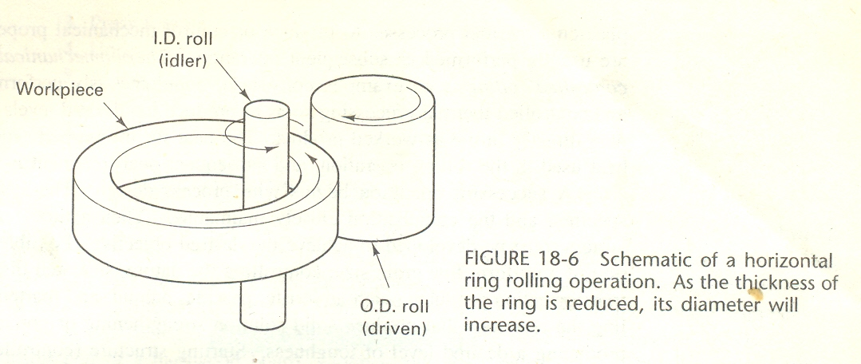
Characteristics of Hot-Rolled Products
Substantial residual stresses can be induced during hot working.

Slide 36
Characteristics of Hot-Rolled Products
Thin sheets often show some definite directional characteristics, whereas thicker plate (such as that above 0.8 in. or 20 mm) will usually have very little.
Because of the high residual stresses in rapidly cooled edges, a complex shape, such as an T- or H-beam, may warp noticeably if a portion of one flange is cut away.

Slide 37
Characteristics of Hot-Rolled Products
As result of hot deformation and good control hot-rolled products are normally of uniform and dependable quality and reliability.
It is quite unusual to find any voids, seams, or laminations when these products are produced by reliable manufacturers.
Surfaces of hot-rolled products are usually a bit rough and are originally covered with a tenacious high-temperature oxide, known as mill scale.

Slide 38
Characteristics of Hot-Rolled Products
Removed by an acid pickling operation, resulting in a surprisingly smooth surface finish.
Dimensional tolerances of hot-rolled products vary with kind of metal and size of the product.
For most products produced in reasonably large tonnages, tolerances are within 2 to 5% of specified dimension (either height or width).

Slide 39
Flatness Control and Rolling Defects
Rolling of flat material with uniform thickness requires uniform gap between rolls attaining such an objective may be difficult.
Consider upper roll in a set that is rolling sheet or plate material presses upward in the middle of roll supported in mill frame.

Slide 40
Flatness Control and Rolling Defects
Roll is loaded in three-point bending and tends to flex in a manner that produces a thicker center and thinner edge.
If roll is always used to roll same material at same temperature, forces and deflections can be predicted, and roll can be designed to have a specified amount of crowning.
When roll is subjected to a specified load, it will “deflect into flatness”.

Slide 41
Flatness Control and Rolling Defects
If applied load is not of designed magnitude, profile will not be flat and defects may result.
The thinner material will try to become longer but must remain attached to the thicker. Result may be wavy edges or fractures in center. If correction is excessive, center becomes thinner and longer, and result can be a wavy center or cracking of the edges.

Slide 42
Thermo-mechanical Processing and Controlled Rolling
A rolling process is generally used as being a means of changing shape of material.
Heat may be used to reduce forces and promote plasticity while mechanical properties (heat treatments) are usually performed as subsequent operations.
Thermo-mechanical processing consists of both deformation and controlled thermal processing to produce desired levels of strength and toughness in the working product.

Slide 43
Thermo-mechanical Processing and Controlled Rolling
Possible goals of thermo mechanical includes :-
Production of uniform fine grain size
Controlling nature
Size and distribution of various transformation products (such as ferrite, pearlite, bainite, and martensite in steels)
Controlling the reactions that produce solid solution strengthening or precipitation hardening
Producing a desired level of toughness.

Slide 44
Thermo-mechanical Processing and Controlled Rolling
Following must all be specified and controlled:-
Starting structure (controlled by composition and prior thermal treatments),
deformation details,
temperature during the various stages of deformation,
the cool down from the working temperature.

Slide 45
Thermo-mechanical Processing and Controlled Rolling
Computer-controlled rolling facilities are almost a necessity if thermo-mechanical processing is to be performed successfully.
Possible benefits of thermo-mechanical processing include
improved product properties;
substantial energy savings (by eliminating subsequent heat treatment);
Possible substitution of a cheaper, less-alloyed metal for a highly alloyed one that responds to heat treatment.

